Slide 1
Pitfalls of Linear Regression Model in Classification
Linear regression model outputs continuous values, and consequently extra steps (based on unknown decision rules) are needed to convert these values to the desired discrete labels.
The predicted values are not probabilistic not letting us make meaningful interpretations.

Slide 2
Previous Classification Models
Perceptron
Generates a random separating hyperplane
Intended for linearly separable data
Support Vector Machine (SVM)
Finds a separating hyperplane that has maximum margin to the data points
Fails in the presence of nonlinear decision boundaries

Slide 3
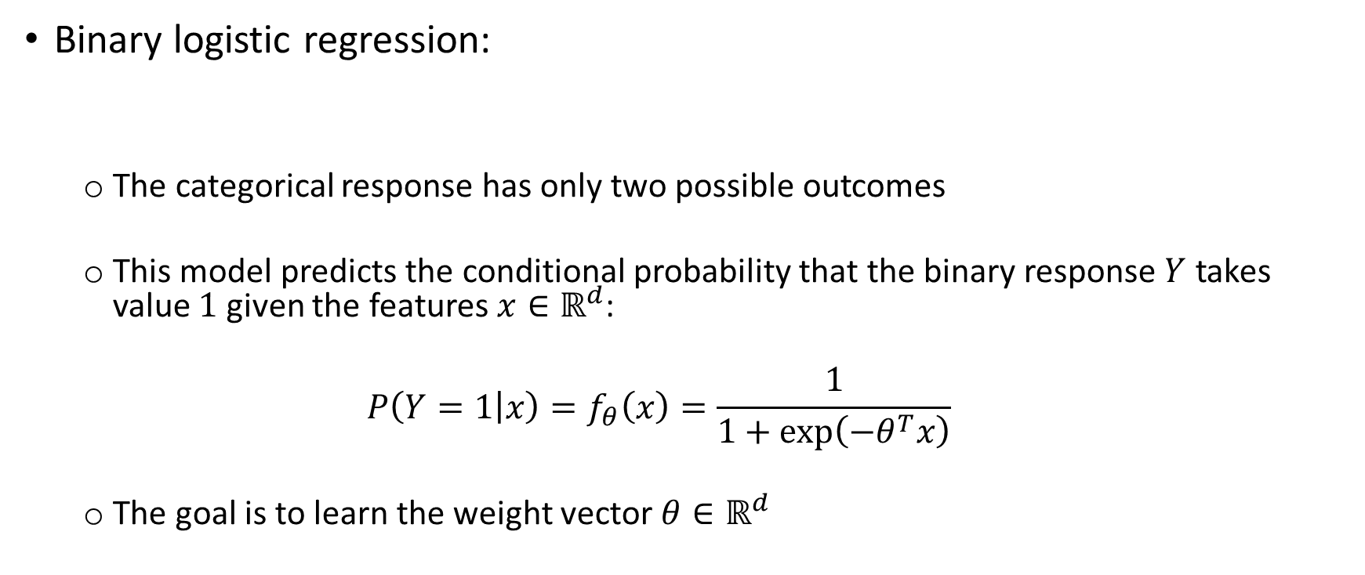
Logistic Regression Theory
Binary logistic regression:
The categorical response has only two possible outcomes
This model predicts the conditional probability that the binary response $Y$ takes value $1$ given the features $x∈ℝ^{d}$:
$$P\left(Y=1 | x\right)=f_{θ}\left(x\right)=\frac{1}{1+\exp\left(−θ^{T}x\right)}$$
The goal is to learn the weight vector $θ∈ℝ^{d}$

Slide 4
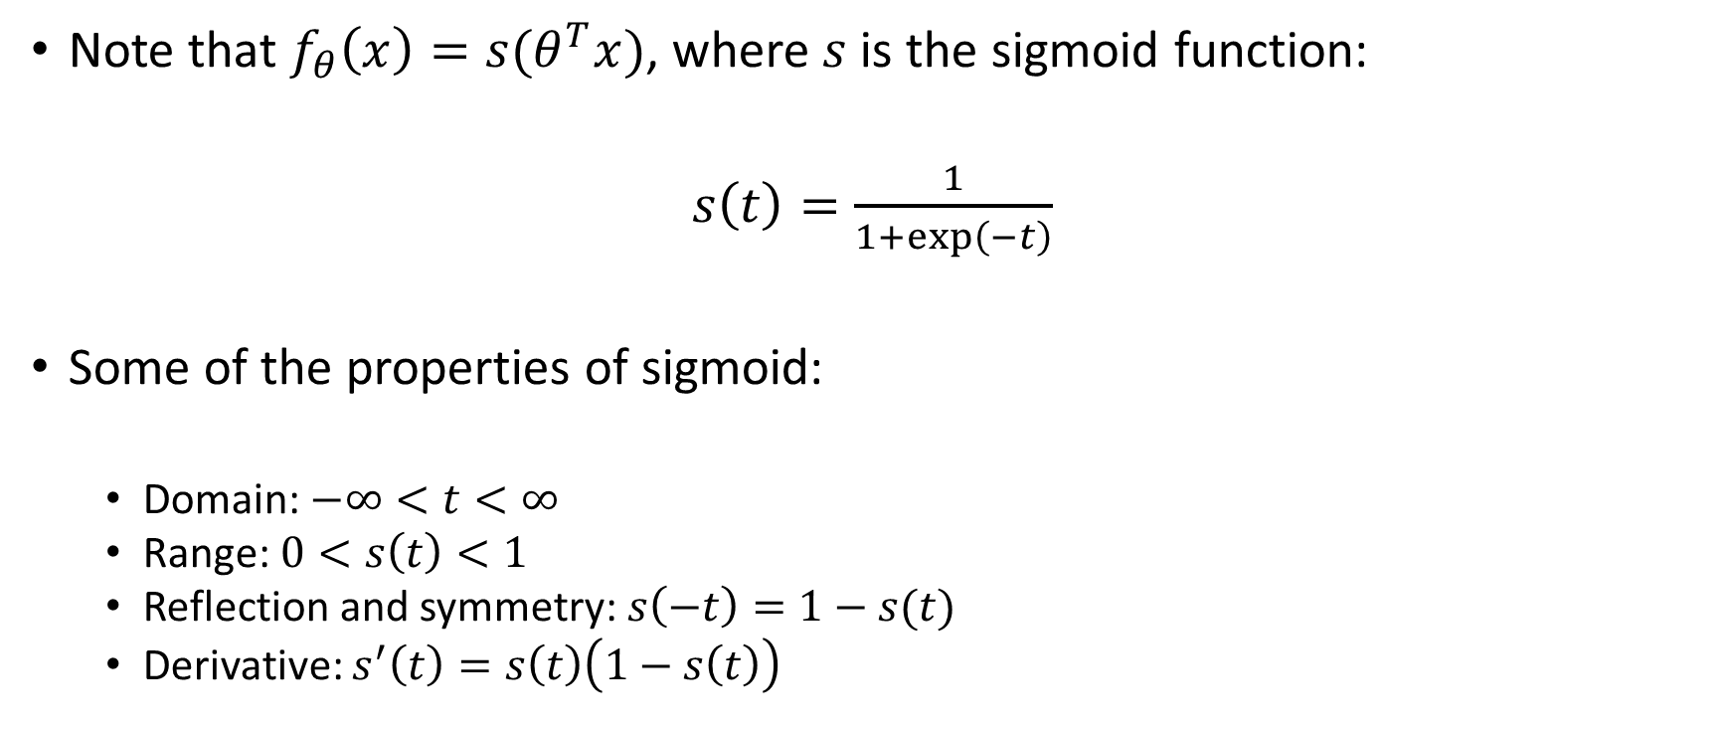
Logistic Activation Function
Note that $f_{θ}\left(x\right)=s(θ^{T}x)$, where $s$ is the sigmoid function:
$s\left(t\right)=\frac{1}{1+\exp\left(−t\right)}$
Some of the properties of sigmoid:
Domain: $−∞<t<∞$
Range: $0<s\left(t\right)<1$
Reflection and symmetry: $s\left(−t\right)=1−s(t)$
Derivative: $s^{′}\left(t\right)=s\left(t\right)\left(1−s\left(t\right)\right)$

Slide 5
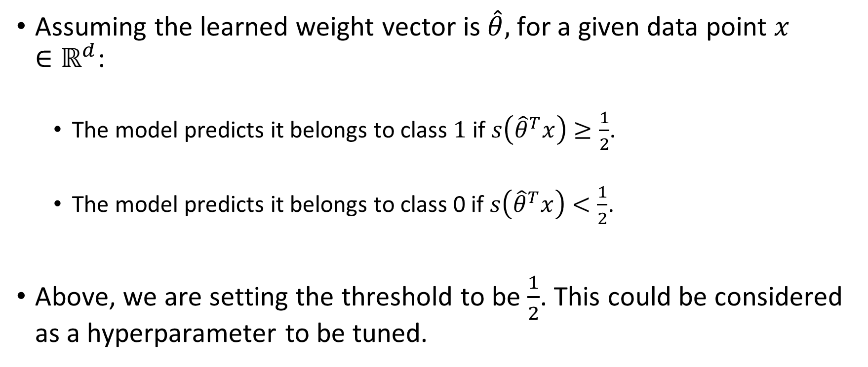
Decision Rule
Assuming the learned weight vector is $\hat{θ},$ for a given data point $x∈ℝ^{d}$:
The model predicts it belongs to class $1$ if $s\left({\hat{θ}}^{T}x\right)≥\frac{1}{2}$.
The model predicts it belongs to class 0 if $s\left({\hat{θ}}^{T}x\right)<\frac{1}{2}$.
Above, we are setting the threshold to be $\frac{1}{2}$. This could be considered as a hyperparameter to be tuned.

Slide 6
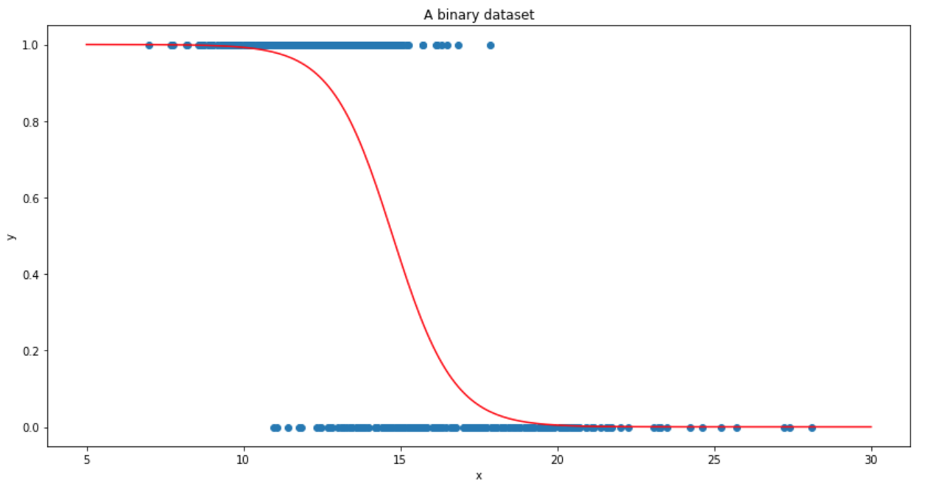
Here’s an example of a logistic regression model fit to a binary class dataset. You can see the sigmoid shape trying to fit to the blue data points.

Slide 7
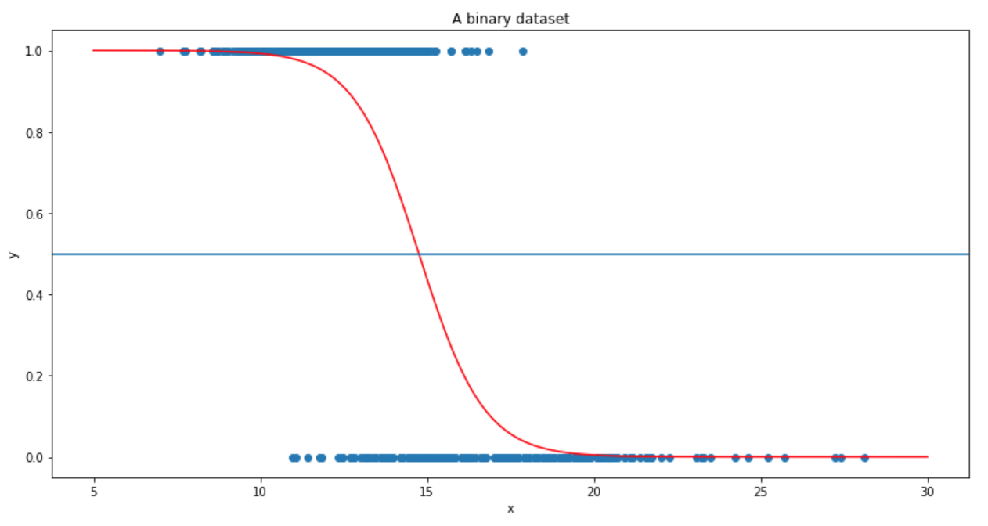
The horizontal blue line at y = 0.5 is the probability threshold, and it intersects with x at around x = 15. So any point left of x = 15 would be classified as 1, while the rest would be classified as 0.

Slide 8
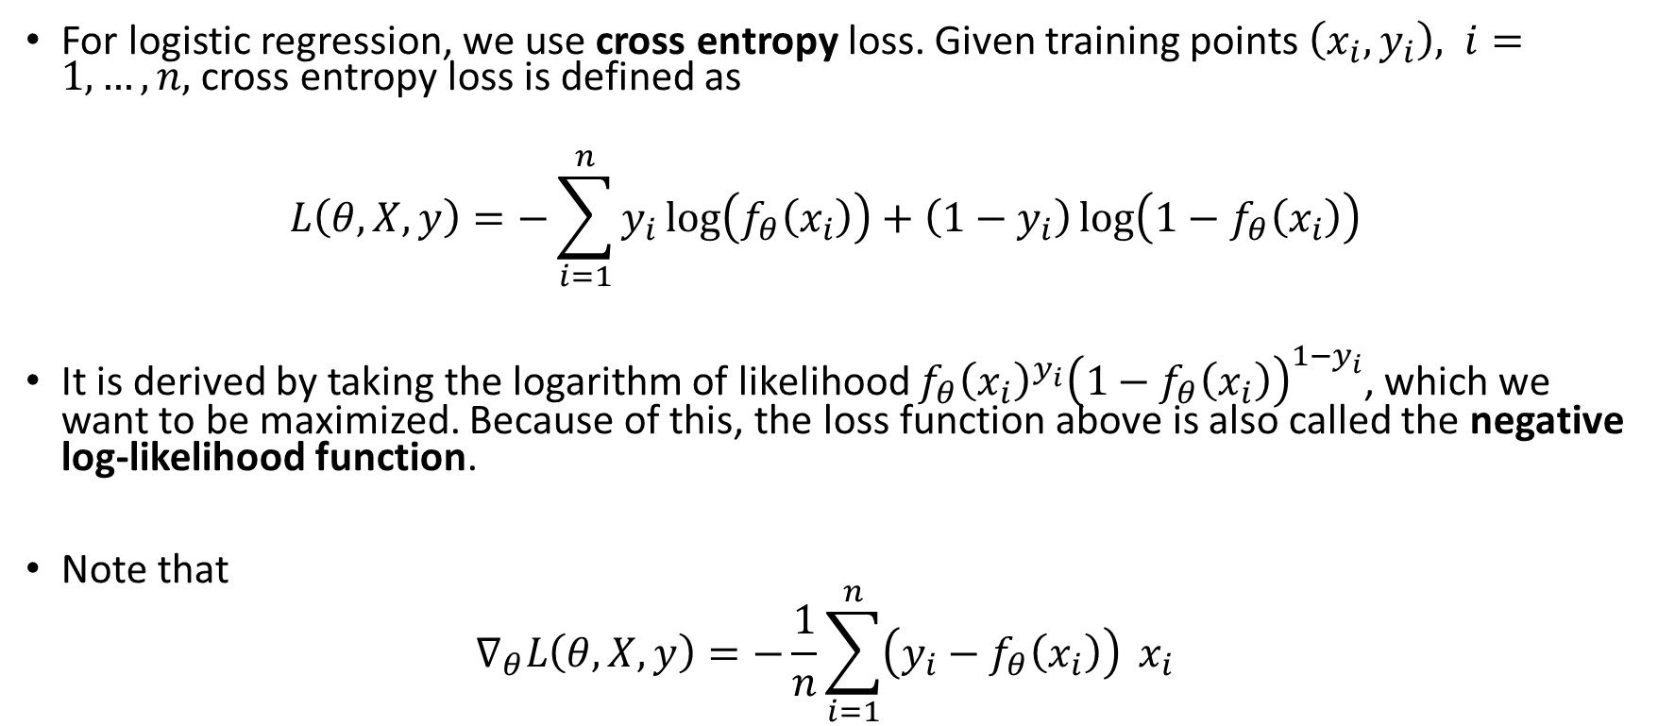
Loss Function
For logistic regression, we use cross entropy loss. Given training points $\left(x_{i},y_{i}\right), i=1,…,n,$cross entropy loss is defined as
$$L\left(θ,X,y\right)=−\sum_{i=1}^{n}{y_{i}\log\left(f_{θ}\left(x_{i}\right)\right)+\left(1−y_{i}\right)\log\left(1−f_{θ}\left(x_{i}\right)\right)}$$
It is derived by taking the logarithm of likelihood $f_{θ}{\left(x_{i}\right)}^{y_{i}}{\left(1−f_{θ}\left(x_{i}\right)\right)}^{1−y_{i}}$, which we want to be maximized. Because of this, the loss function above is also called the negative log-likelihood function.
Note that
$$∇_{θ}L\left(θ,X,y\right)=−\frac{1}{n}\sum_{i=1}^{n}{\left(y_{i}−f_{θ}\left(x_{i}\right)\right)} x_{i}$$

Slide 9
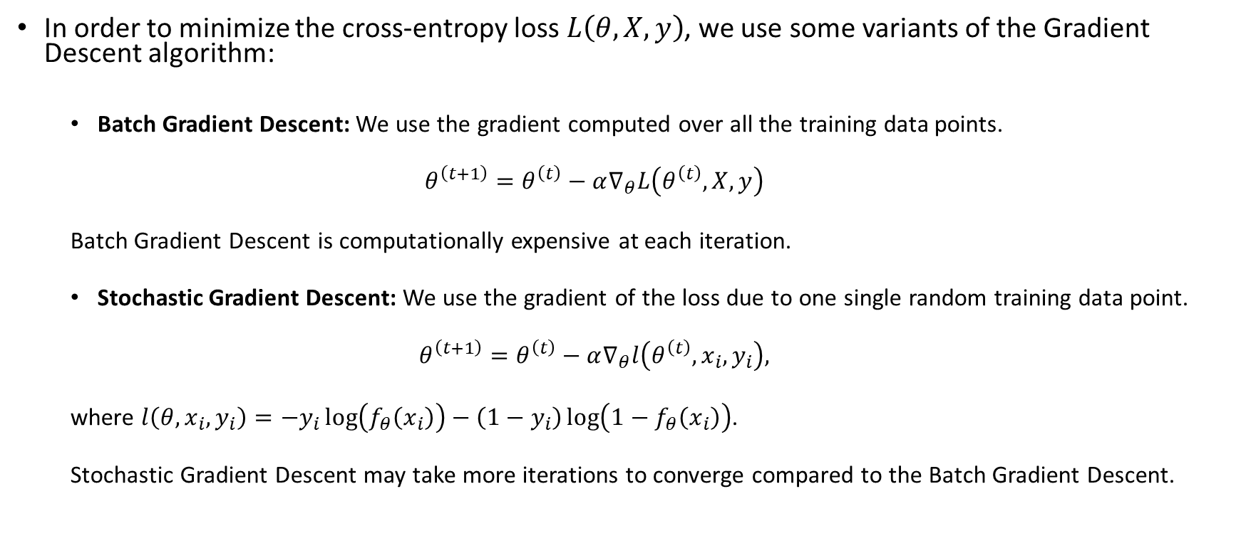
Training a Logistic Regression Model (1)
In order to minimize the cross-entropy loss $L\left(θ,X,y\right)$, we use some variants of the Gradient Descent algorithm:
Batch Gradient Descent: We use the gradient computed over all the training data points.
$$θ^{\left(t+1\right)}=θ^{\left(t\right)}−α∇_{θ}L\left(θ^{\left(t\right)},X,y\right)$$
Batch Gradient Descent is computationally expensive at each iteration.
Stochastic Gradient Descent: We use the gradient of the loss due to one single random training data point.
$$θ^{\left(t+1\right)}=θ^{\left(t\right)}−α∇_{θ}l\left(θ^{\left(t\right)},x_{i},y_{i}\right),$$
where $l\left(θ,x_{i}, y_{i}\right)={−y}_{i}\log\left(f_{θ}\left(x_{i}\right)\right)−\left(1−y_{i}\right)\log\left(1−f_{θ}\left(x_{i}\right)\right)$.
Stochastic Gradient Descent may take more iterations to converge compared to the Batch Gradient Descent.

Slide 10
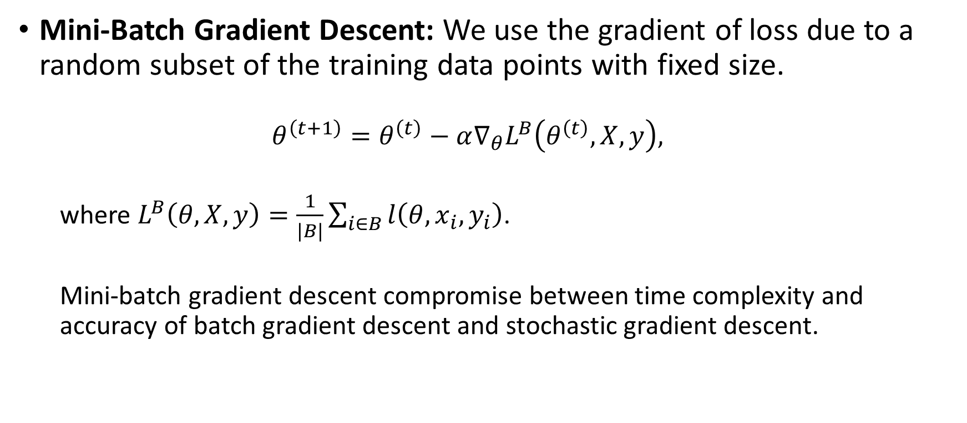
Training a Logistic Regression Model (2)
Mini-Batch Gradient Descent: We use the gradient of loss due to a random subset of the training data points with fixed size.
$$θ^{\left(t+1\right)}=θ^{\left(t\right)}−α∇_{θ}L^{B}\left(θ^{\left(t\right)},X,y\right),$$
where $L^{B}\left(θ,X,y\right)=\frac{1}{|B|}\sum_{i∈B}{l\left(θ,x_{i},y_{i}\right)}$.
Mini-batch gradient descent compromise between time complexity and accuracy of batch gradient descent and stochastic gradient descent.

Slide 11
Evaluation Metrics of Classification Models (1)
Accuracy
The accuracy of the classifier is defined as the ratio of its correct predictions to the number of test point.
Confusion Matrix
The confusion matrix compares what the model predicts with the actual counts in each class.

Slide 12
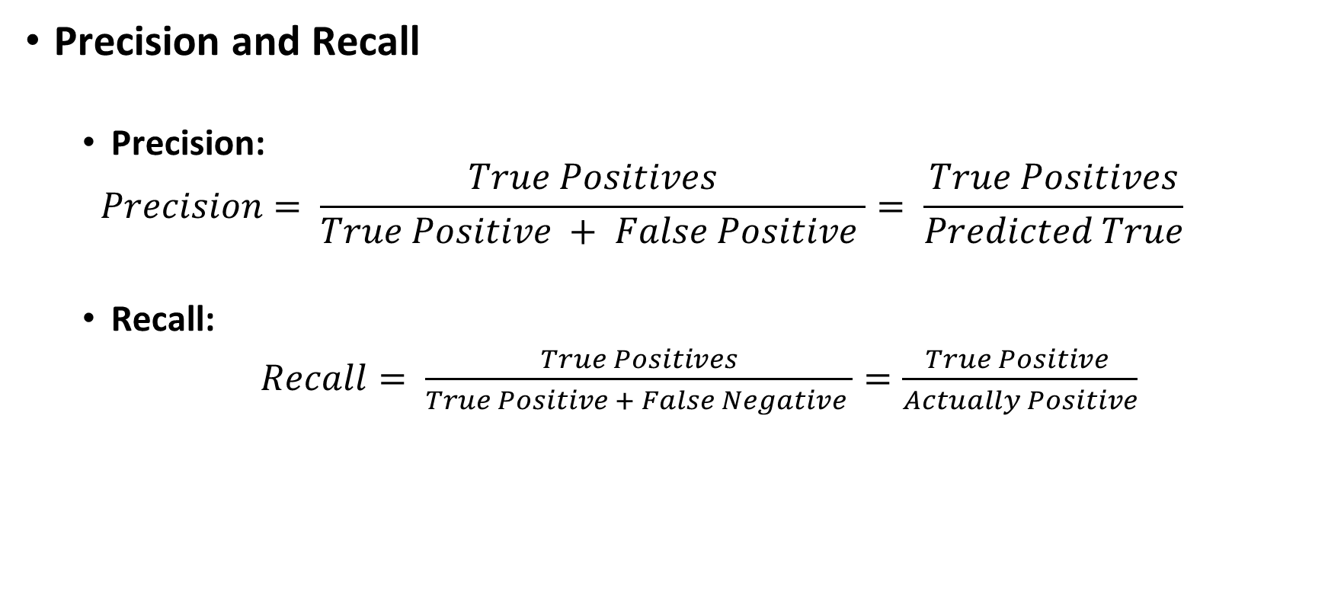
Evaluation Metrics of Classification Models (2)
Precision and Recall
Precision:
$$Precision= \frac{True Positives}{True Positive + False Positive }= \frac{True Positives}{Predicted True}$$
Recall:
$Recall= \frac{True Positives}{True Positive + False Negative }=\frac{True Positive }{Actually Positive}$

Slide 13
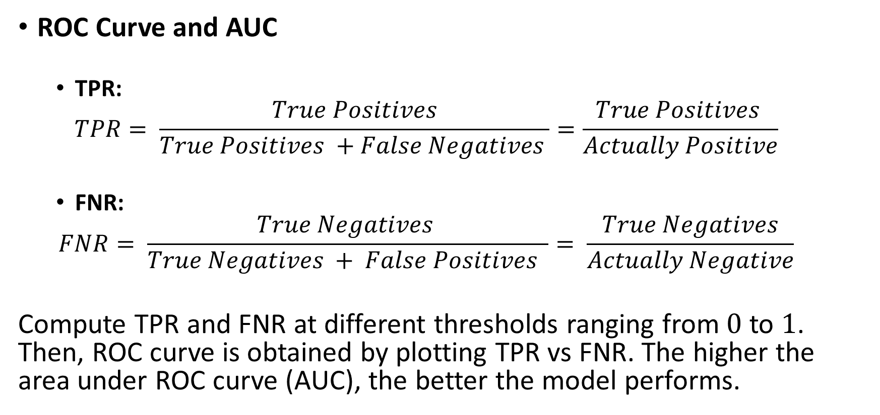
Evaluation Metrics of Classification Models (3)
ROC Curve and AUC
TPR:
$$TPR= \frac{True Positives}{True Positives +False Negatives }=\frac{True Positives }{Actually Positive}$$
FNR:
$$FNR= \frac{True Negatives }{True Negatives + False Positives }= \frac{True Negatives}{Actually Negative}$$
Compute TPR and FNR at different thresholds ranging from $0$ to $1$. Then, ROC curve is obtained by plotting TPR vs FNR. The higher the area under ROC curve (AUC), the better the model performs.

Slide 14
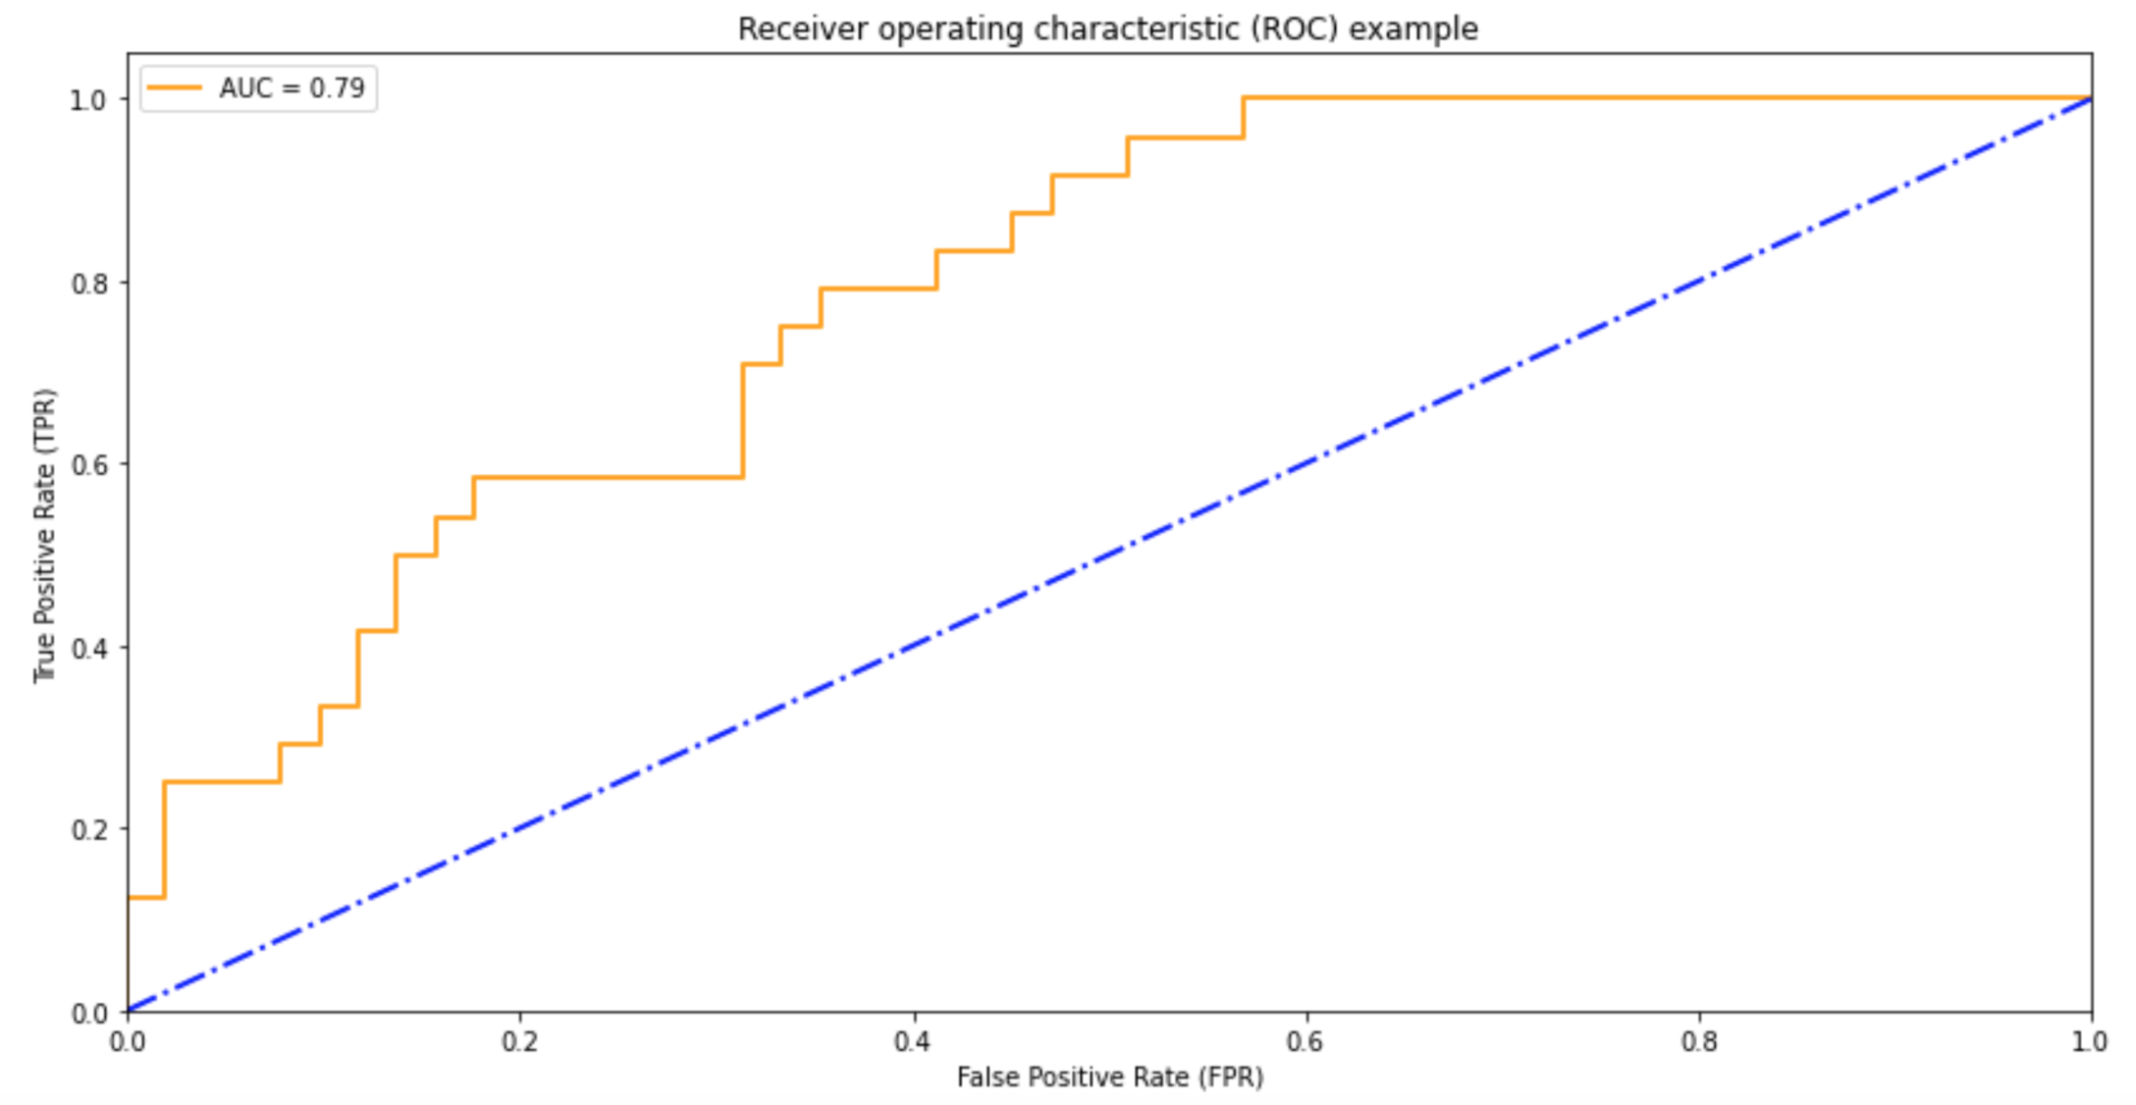
Here’s a ROC Curve example. The closer to the top right corner the curve is (and therefore the closer to 1 the AUC is) the more robust the model

Slide 15
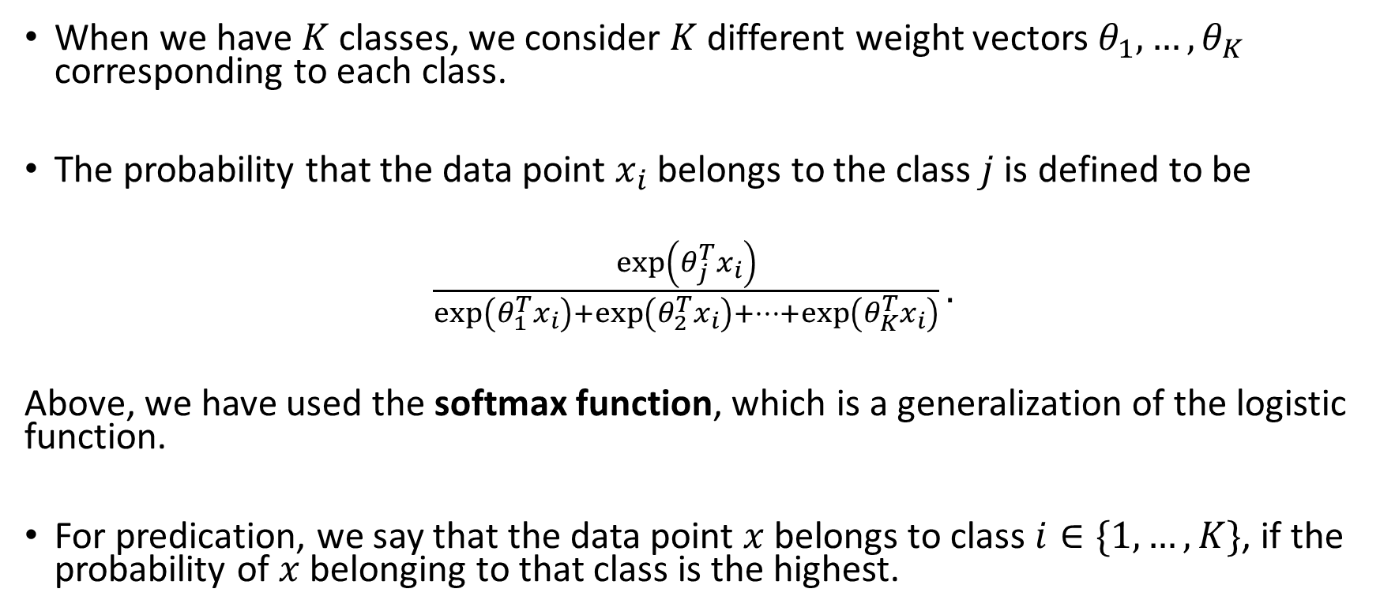
From Binary to Multiclass Classification
When we have $K$ classes, we consider $K$ different weight vectors $θ_{1}, …, θ_{K}$ corresponding to each class.
The probability that the data point $x_{i}$ belongs to the class $j$ is defined to be
$\frac{\exp\left(θ_{j}^{T}x_{i}\right)}{\exp\left(θ_{1}^{T}x_{i}\right)+\exp\left(θ_{2}^{T}x_{i}\right)+…+\exp\left(θ_{K}^{T}x_{i}\right)}.$
Above, we have used the softmax function, which is a generalization of the logistic function.
For predication, we say that the data point $x$ belongs to class $i∈\{1,…,K\}$, if the probability of $x$ belonging to that class is the highest.

Slide 16
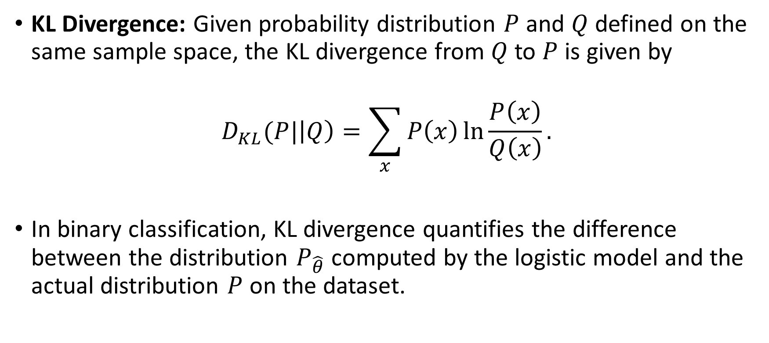
Bonus: Probabilistic Interpretation (1)
KL Divergence: Given probability distribution $P$ and $Q$ defined on the same sample space, the KL divergence from $Q$ to $P$ is given by
$$D_{KL}(P|\left|Q\right)=\sum_{x}{P\left(x\right)\ln{\frac{P\left(x\right)}{Q\left(x\right)}}}.$$
In binary classification, KL divergence quantifies the difference between the distribution $P_{\hat{θ}}$ computed by the logistic model and the actual distribution $P$ on the dataset.

Slide 17
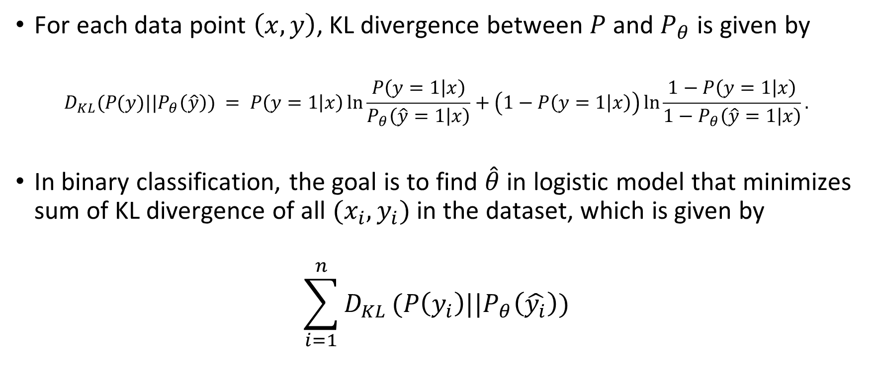
Bonus: Probabilistic Interpretation (2)
For each data point $\left(x,y\right)$, KL divergence between $P$ and $P_{θ}$ is given by
$$D_{KL}(P(y)||P_{θ}\left(\hat{y}\right)) = P\left(y=1 | x\right)\ln{\frac{P\left(y=1 | x\right)}{P_{θ}\left(\hat{y}=1 | x\right)}}+\left(1−P\left(y=1 | x\right)\right)\ln{\frac{1−P\left(y=1 | x\right)}{1−P_{θ}\left(\hat{y}=1 | x\right)}}.$$
In binary classification, the goal is to find $\hat{θ}$ in logistic model that minimizes sum of KL divergence of all $(x_{i},y_{i})$ in the dataset, which is given by
$$\sum_{i=1}^{n}{D_{KL}}(P\left(y_{i}\right)||P_{θ}\left(\hat{y_{i}}\right))$$

Slide 18
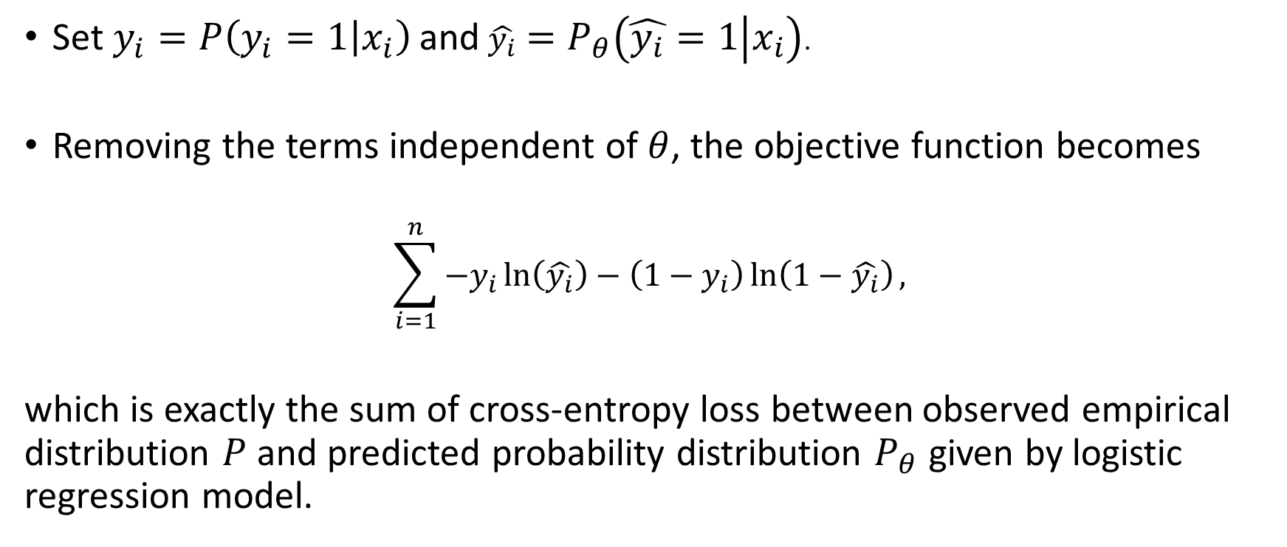
Bonus: Probabilistic Interpretation (3)
Set $y_{i}=P\left(y_{i}=1 | x_{i}\right)$ and $\hat{y_{i}}=P_{θ}\left(\hat{y_{i}}=1 | x_{i}\right)$.
Removing the terms independent of $θ$, the objective function becomes
$$\sum_{i=1}^{n}{−y_{i}\ln\left(\hat{y_{i}}\right)−\left(1−y_{i}\right)\ln\left(1−\hat{y_{i}}\right)},$$
which is exactly the sum of cross-entropy loss between observed empirical distribution $P$ and predicted probability distribution $P_{θ}$ given by logistic regression model.

